Slide 1

Cybersecurity & Ethics Lake Superior college Advanced GenCyber camp
2024

Slide 2
AGENDA / Intro
Introduction
Understanding Cybersecurity
Ethics in Cybersecurity
Demonstration: Password Security
Cyber Ethics Role-Playing Game (RPG)
Conclusion & Q&A
Notes:
Greetings and Quick Poll “How many of you use the internet every day?”
Every interaction with any online digital services is like leaving our fingerprint behind, it creates a giant trail of data that others can user to piece together information about you. This presentation will help to teach you about cybersecurity, its importance, the power that comes with the knowledge, why we must use it in the proper ways, as well as some tips on how you can keep yourself safe online.
At the end, we will take what we’ve learned and play a little role-playing game!
How this will work is we will get started by understanding what cybersecurity is. Then we will talk about what power it comes with and why we use it responsibly. We will then do a demonstration on password security, followed by the cyber ethics game. We will keep some time at the end to answer all of your questions. Let’s get started!

Slide 3
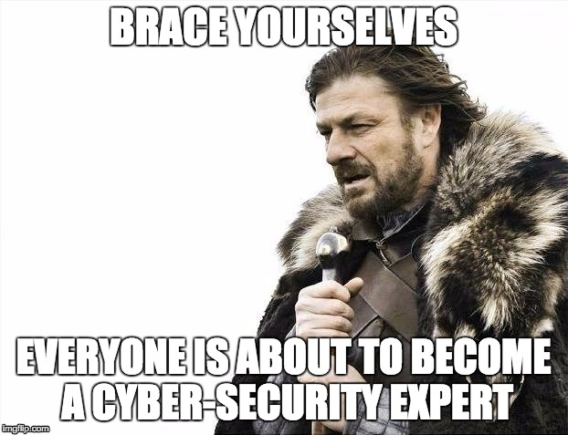
Understanding cybersecurity
Notes:
How many of you use the internet everyday?

Slide 4
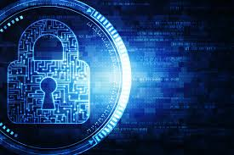
What is cybersecurity?
Cybersecurity is the art of protecting networks, devices, and data from unauthorized access.
That means protecting our computers and information from people who might want to steal or even damage it!
It’s important because it helps keep our personal information safe, like messages, photos, and passwords!
With great power, comes great responsibility. It’s important that we do the right things with the access that we have!
Our main goal is to keep everyone and their data safe.

Slide 5
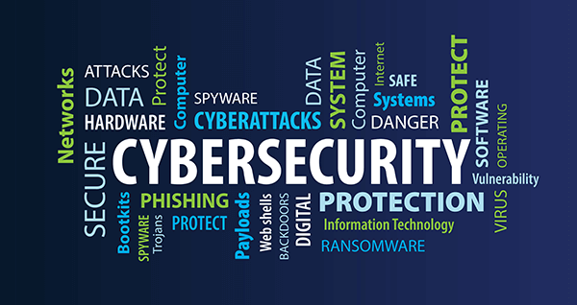
Why is cybersecurity important?
The main reason it’s so important is because of how much we rely on computers!
Most people user their computers or cell phones every single day.
Imagine if someone were to access all the information on your smartphone or computer, wouldn’t that be scary?
Nearly everyone has really important information stored on computers, the internet, or somewhere digital. It’s our job to protect it!
Beyond just personal information, the important protected data of governments and businesses is also in need of protecting!

Slide 6
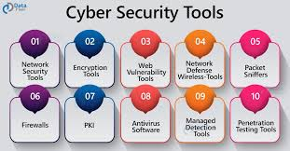
How does cybersecurity work?
Cybersecurity is Everyone’s Responsibility!
We use special tools and software (like antivirus) as well as smart practices (like not sharing passwords) to keep data safe.
We try to provide as much education to everyone as possible, to get them to understand the dangers. Just like this!
As an example, when your Steam or PS5 games update, that’s not always just about new features; it’s also to fix security holes that hackers could use to sneak into your device!

Slide 7
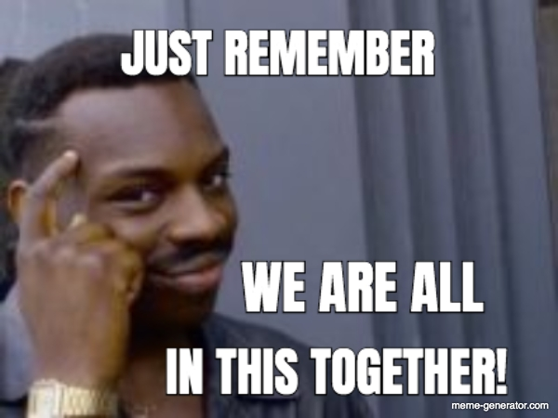
Everyone’s responsibility?
What do you mean it’s everyone’s responsibility?
Just like in sports or at school, everyone has a role!
In Cybersecurity, your role is to follow good habits online – Like creating strong passwords and not clicking on strange links!
When you protect your information, you also help to make the internet safer for your friends and family.

Slide 8
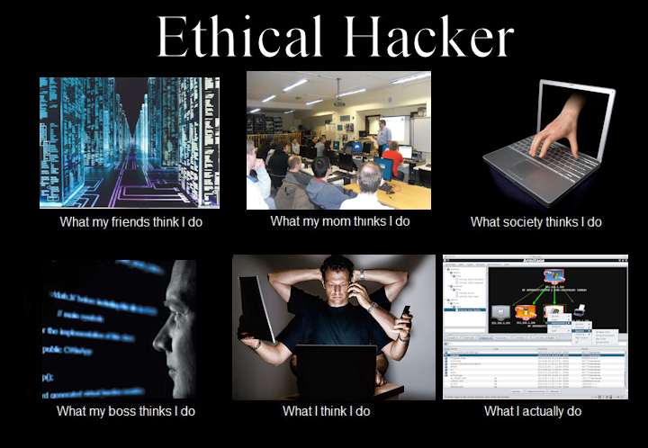
Ethics and cybersecurity
Notes:
How many of you use the internet everyday?

Slide 9
Ethics and Cybersecurity
What are ethics?
Ethics are the rules that help us decide what’s right and wrong.
It’s about making the choices that are fair and respectful for everyone.
In Cybersecurity, ethics help us decide how to protect information and what to do when we face choices.
For instance, like sharing someone else’s secrets or using someone else’s account without permissions.

Slide 10
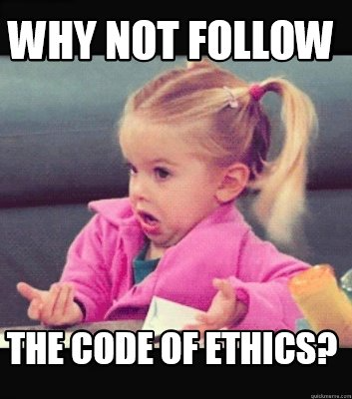
Common ethical dilemmas
Imagine you find a USB drive at school. Do you use it to see what’s on it?
What if you know a friend’s password? Is it OK to log into their account just for fun?
The answer to both is no!

Slide 11
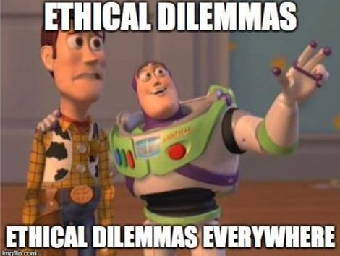
Making ethical decisions
Steps to Decide:
Think: Consider what could happen as a result of your actions.
Judge: Decide if your action could hurt someone in some way or be unfair.
Act: Choose to do what’s right, even if it’s not the easiest option.
Guiding Questions:
Who could be affected by this?
Is this fair to everyone involved?
How would I feel if someone did this to me?

Slide 12

Importance of ethical behavior
Being ethical helps build trust with friends and makes the online world safer for everyone.
Your reputation has long-lasting impacts. Making ethical choices helps build your reputation and personal relationships.
Golden Rule Online: Treat others online as you want to be treated. Whether its chatting, gaming, or sharing, always choose kindness and fairness.

Slide 13

Time to play a game!
Notes:
How many of you use the internet everyday?

Slide 14
Role Playing game:
Now we will play a little game about Ethics!
You will now split into your teams.
You will be given a prompt, and you must discuss amongst your team the proper action your team should take.
After a few minutes, you will present your decision and reasoning to the rest of the class.

Slide 15
Scenario 1: Finding a lost phone
Scenario: You find a smartphone in the school cafeteria. It’s unlocked, and you see messages popping up. What do you do next?
Choice 1: Try to find the owner using the information available on the phone.
Choice 2: Leave it at the lost and found.
Choice 3: Snoop through the messages and photos.

Slide 16
Scenario 2: Access a friends account
Scenario: Your friend accidentally leaves their social media account logged in to your computer. You see you have access to read all their messages and posts.
Choice 1: Log out immediately.
Choice 2: Read a few messages.
Choice 3: Post something funny as a joke.

Slide 17
Scenario 3: Sharing Content online
Scenario: you receive a funny picture from a friend via a messaging app that was taken during a school event, but it’s slightly embarrassing to another classmate in the photo.
Choice 1: Share the photo with other friends.
Choice 2: Post it on Social Media.
Choice 3: Delete the photo and tell your friend it’s not nice to share such images.

Slide 18
Scenario 4: Downloading software
Scenario: You find a website that offers a free download of a popular video game that usually costs money. The site looks a bit shady and you’re unsure if it’s legal or safe.
Choice 1: Download the game.
Choice 2: Ignore the site and save up to buy the game.
Choice 3: Report the site to a teacher or a parent.

Slide 19
Scenario 5: Receiving a suspicious email
Scenario: You receive an email claiming you have won a big prize, and all you need to do is click on a link to claim it. The email looks official, but you weren’t expecting any prizes.
Choice 1: Click the link to see what the prize is.
Choice 2: Delete the email.
Choice 3: Discuss it with a parent or teacher before doing anything.

Slide 20
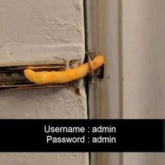
Password security
Notes:
How many of you use the internet everyday?

Slide 21
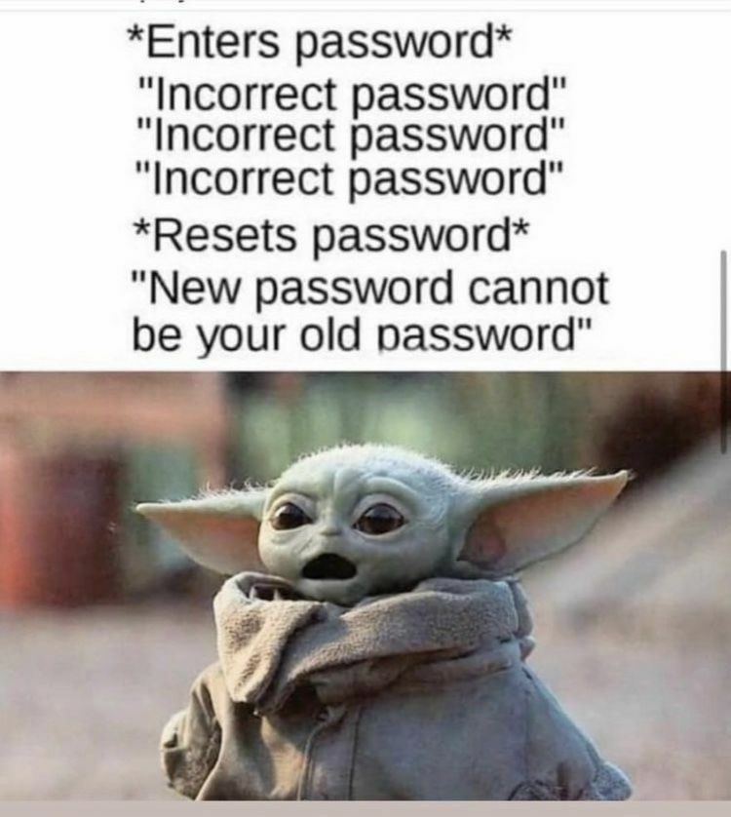
Why strong passwords matter:
Passwords are like keys to your digital house. They keep out anyone who shouldn’t have access to your personal stuff online.
A weak password can be guessed easily, letting hackers take over your accounts!
Imagine someone pretending to be you and sending messages to your friends!

Slide 22
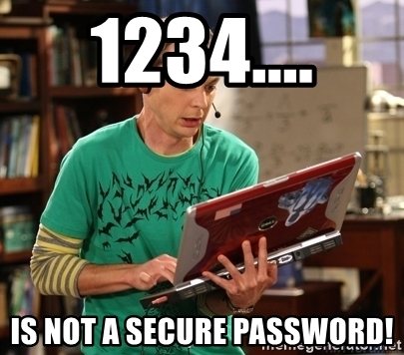
What makes a password strong?
Characteristics of strong passwords:
Length: Aim for 12 characters or more.
Complexity: Use a mix of letters, numbers, and symbols.
Unpredictable: Avoid common words, phrases, or easy patterns like “12345” or “password”.
Bad Password: password123
Great Password: GencyberCamp2024IsAwesome!!

Slide 23
Password activity:
Search online for a password complexity meter like “Password Strength Meter” at https://www.passwordmonster.com/
Think of 10 different passwords that range from good to bad.
Don’t use any passwords that you have actually used in real life!
Check those passwords with the meter, how secure are the passwords that you have come up with?
How long would it take to crack the most secure password you thought of?
Note: Never use real passwords in something like this for your own safety.

Slide 24
THANK YOU

